Slide 1

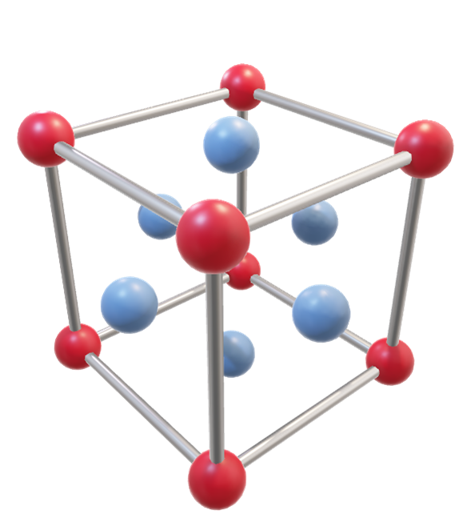
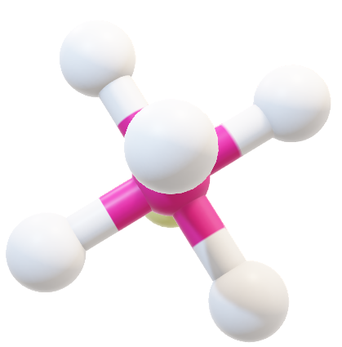
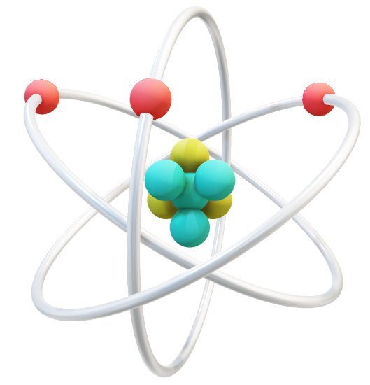
Brittleness of Ionic Compounds
Brittleness of Ionic Compounds
Brittleness of Ionic Compounds
Brittleness of Ionic Compounds
Brittleness of Ionic Compounds

Slide 2
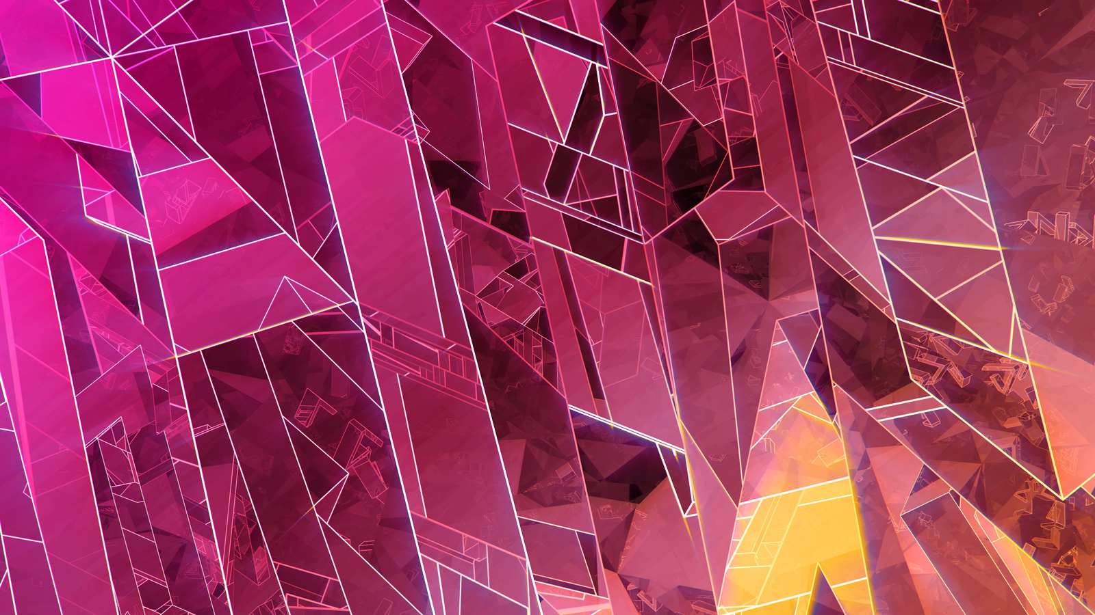

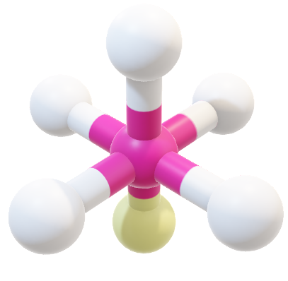

Brittleness of Ionic Compounds
Ionic compound:
Compounds that are held
Together by ionic bonds
are classed as
ionic compounds.
Brittleness of Ionic Compounds
Brittleness of Ionic Compounds
Brittleness of Ionic Compounds
Brittleness of Ionic Compounds

Slide 3
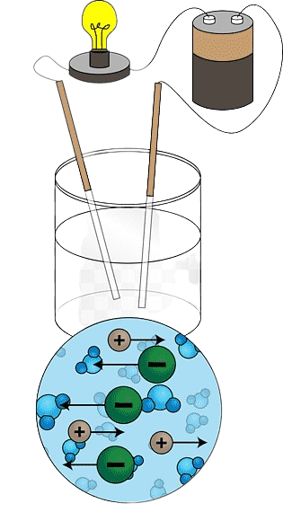
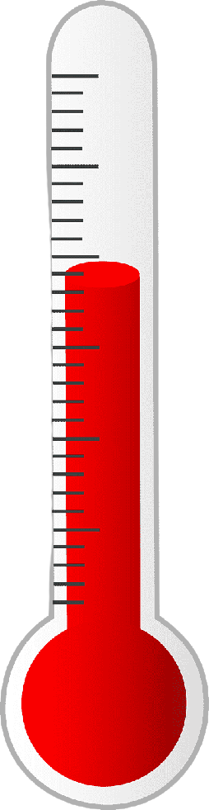
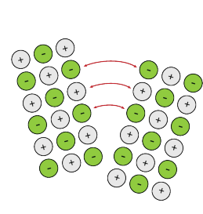
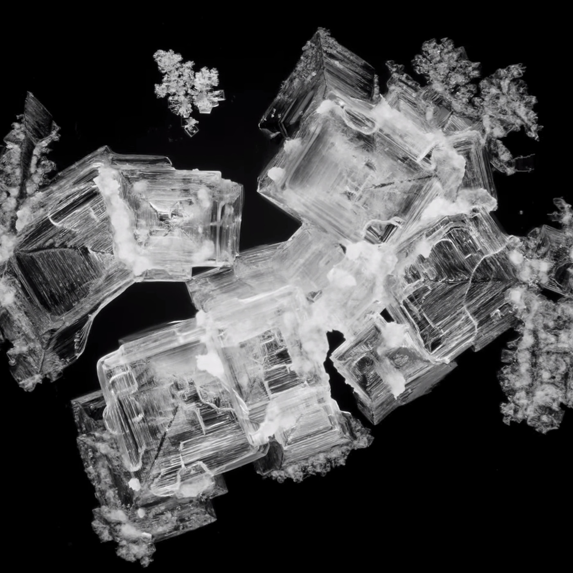

Brittle.
Can create
Crystal.
High melting point,
High boiling point.
Conduct electricity
In water solution.
Ionic compound:
Compounds that are held
Together by ionic bonds
are classed as
ionic compounds.

Slide 4
Ionic compound:
Compounds that are held
Together by ionic bonds
are classed as
ionic compounds.
Brittle.
Can create
Crystal.
High melting point,
High boiling point.
Conduct electricity
In water solution.

Slide 5
Brittleness:
Can create
Crystal.
High melting point,
High boiling point.
Conduct electricity
In water solution.

Slide 6
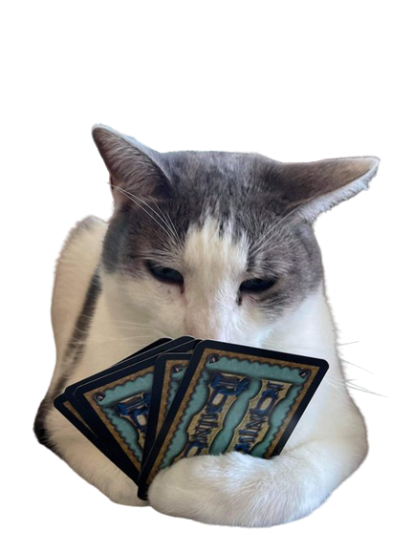

Slide 7
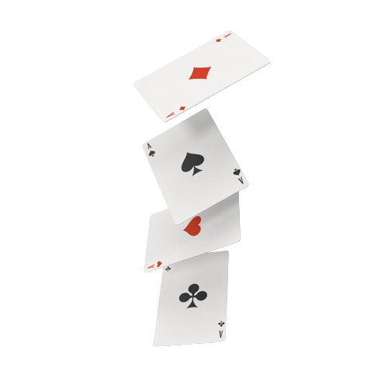
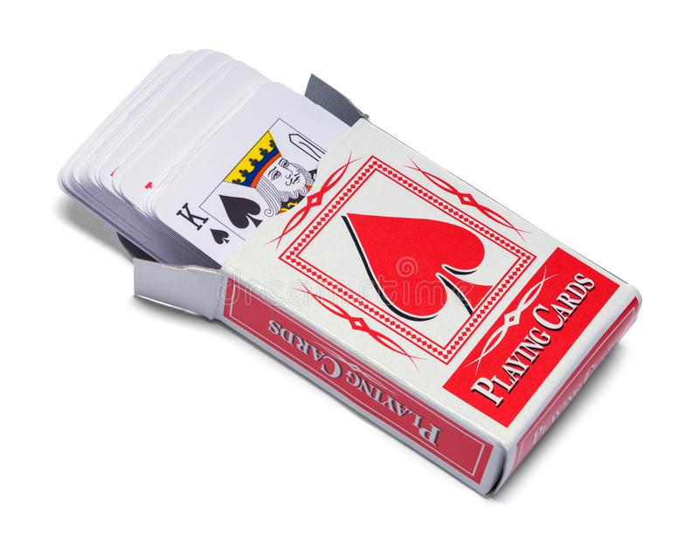
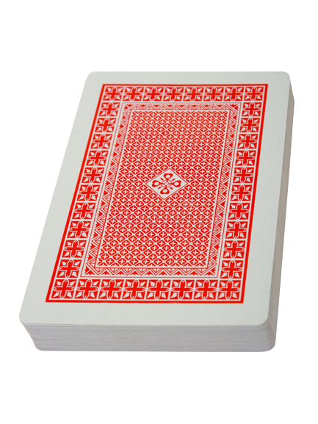
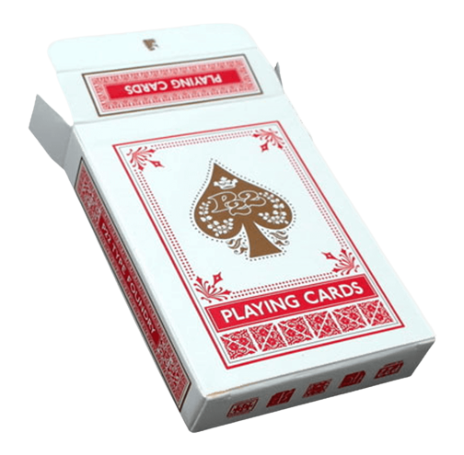
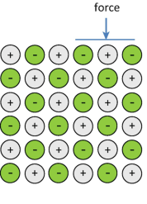
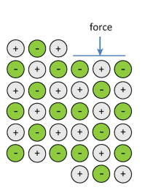

Slide 8
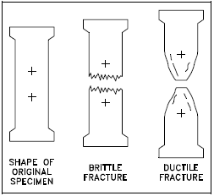
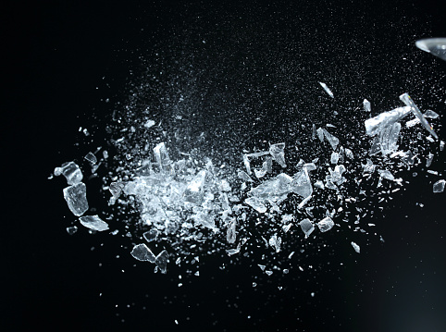
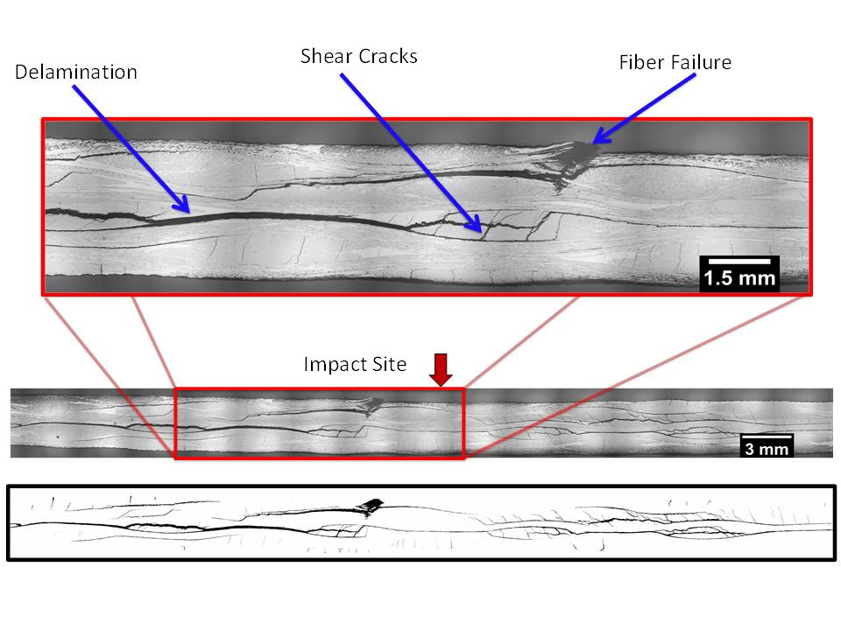
Disadvantages of brittleness:
Brittle materials can easily break
or crack under stress.
Brittleness:
Brittleness is a property of materials
that refers to their tendency to fracture
or break, when external forces are applied to it.
Brittleness mostly causes problems
in a product.
Can create
Crystal.
High melting point,
High boiling point.
Conduct electricity
In water solution.

Slide 9
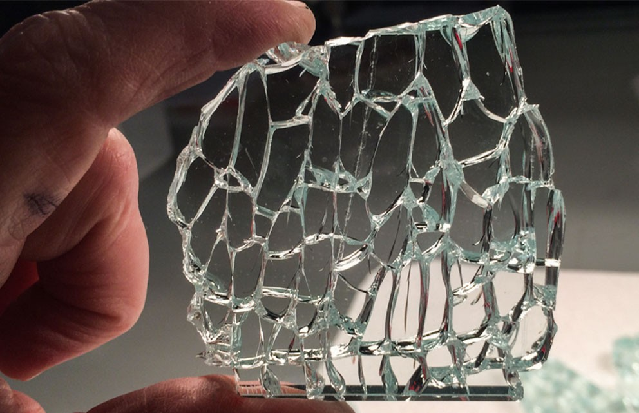
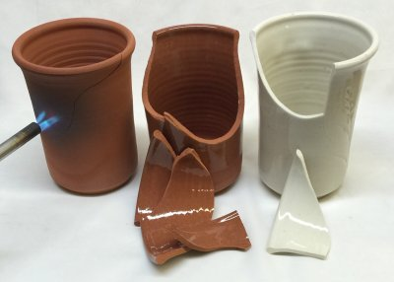
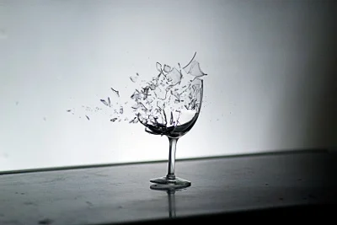
Disadvantages of brittleness:
The brittleness of ionic compounds can also make them vulnerable to thermal shock
Disadvantages of brittleness:
Brittle materials can easily break
or crack under stress.
Brittleness:
Brittleness is a property of materials
that refers to their tendency to fracture
or break, when external forces are applied to it.
Brittleness mostly causes problems
in a product.

Slide 10
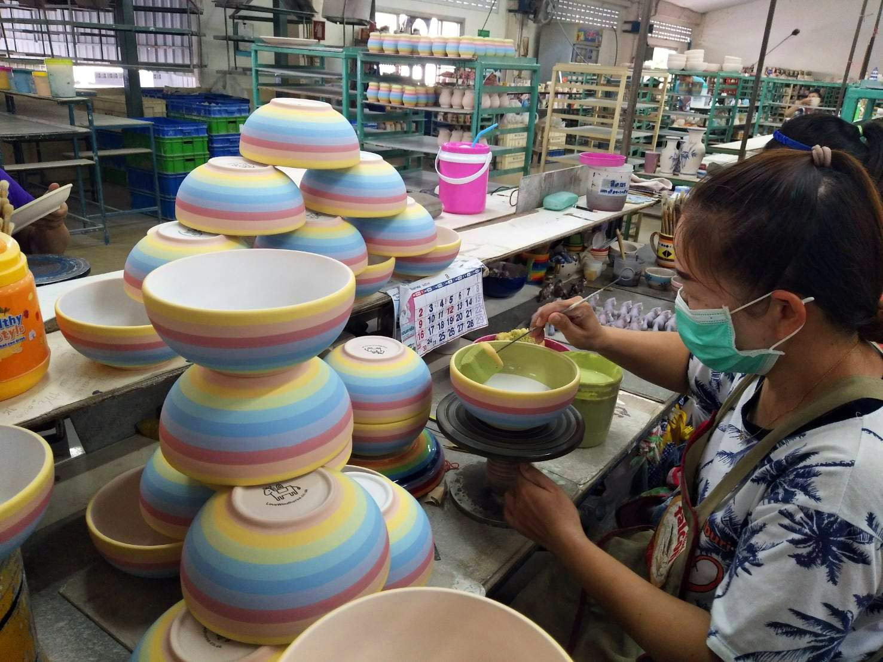
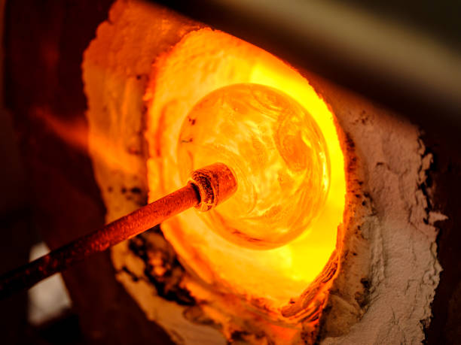
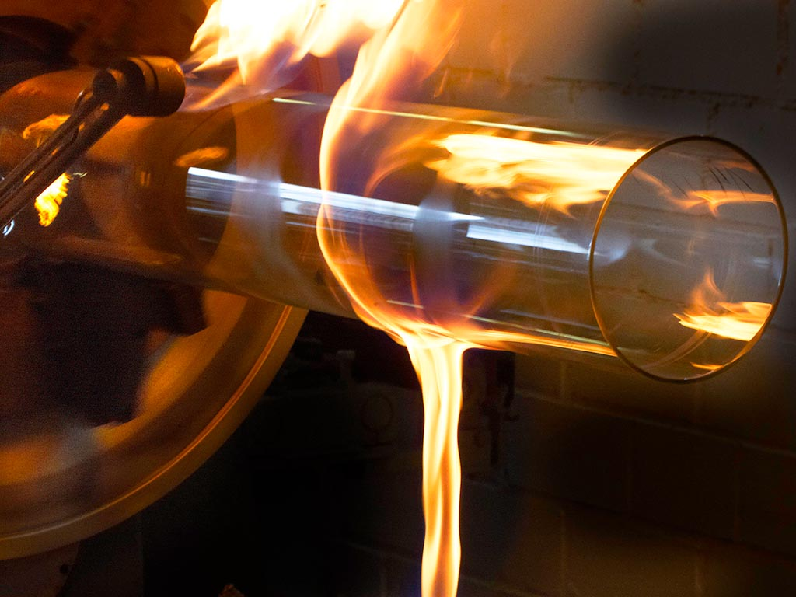
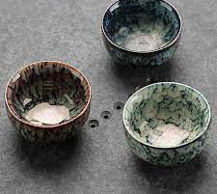
Disadvantages of brittleness:
Difficult to process.
Disadvantages of brittleness:
The brittleness of ionic compounds can also make them vulnerable to thermal shock
Disadvantages of brittleness:
Brittle materials can easily break
or crack under stress.

Slide 11
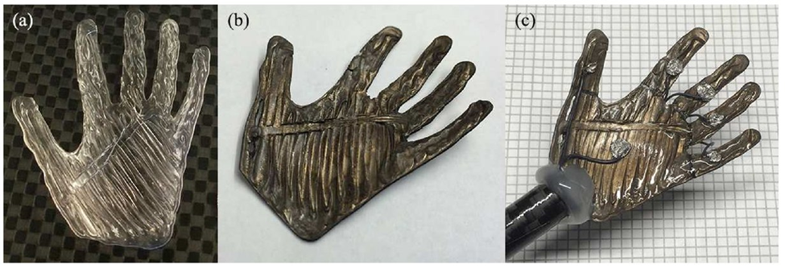
possible solutions to overcome the brittleness problem :
Disadvantages of brittleness:
We can overcome the limitations of brittleness
in ionic compounds through material engineering and design.
Scientists are also developing new composite materials
that combine the desirable properties of ionic compounds
with the toughness and ductility of other materials, such as polymer-metal.
Difficult to process.
Robotics hand made out of polymer-metal material.
Disadvantages of brittleness:
The brittleness of ionic compounds can also make them vulnerable to thermal shock

Slide 12
possible solutions to overcome the brittleness problem :
Disadvantages of brittleness:
We can overcome the limitations of brittleness
in ionic compounds through material engineering and design.
Scientists are also developing new composite materials
that combine the desirable properties of ionic compounds
with the toughness and ductility of other materials, such as polymer-metal.
Difficult to process.
Robotics hand made out of polymer-metal material.
Thank you
Mohua Akter (CSE)
2022-3-60-112.

Slide 13
Thank you
Mohua Akter (CSE)
2022-3-60-112.

